Slide 1
Sales Case Study
By Kin Cheng

Slide 2
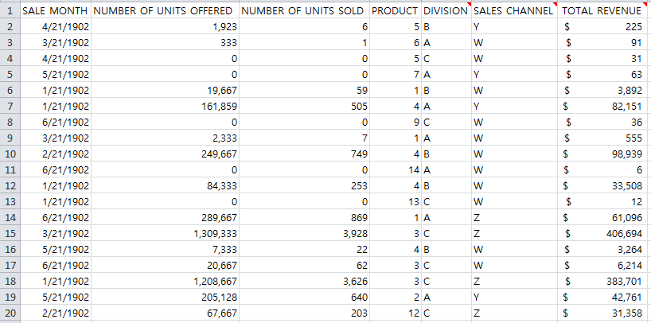
The dataset
4 Divisions
4 Sales channels
14 Products
Units offered: 161.6m
Units sold: 493k
Total Revenue: 48.9m

Slide 3
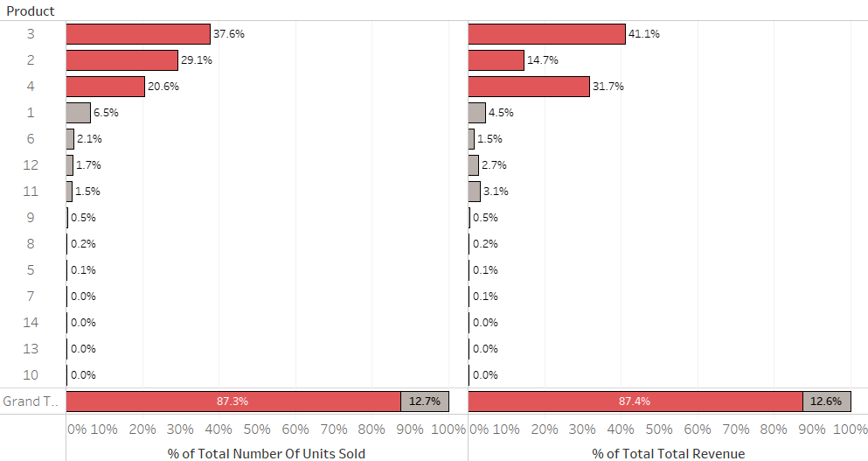
Products
Top three products accounts for 87.3% of total units sold and 87.4% of total revenue

Slide 4
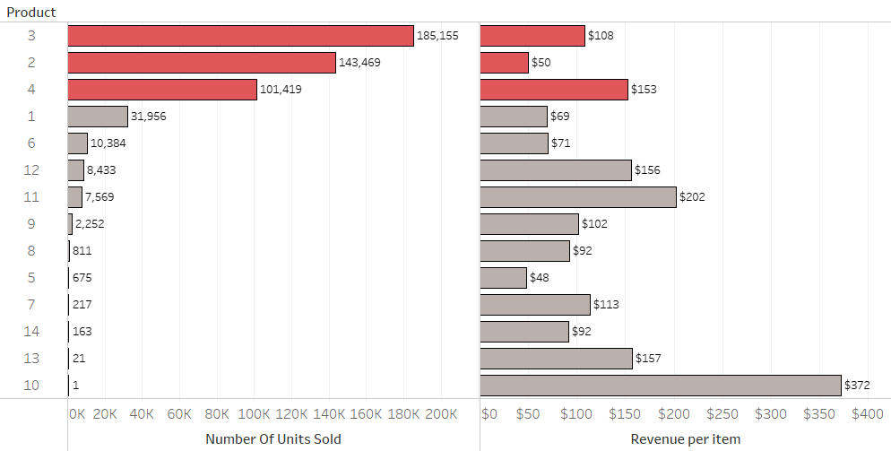
Products
Top three products by units sold are ranked 5th, 7th, and 13th in average revenue

Slide 5
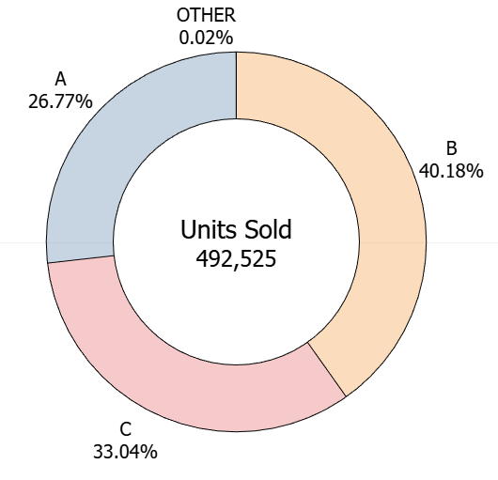
Sales by Division
Division B is leading the enterprise in sales at 40%
Division B through channel Z leads all segments at 20% of total sales
Division “Other” had a total of 76 units sold
Notes:
-Division B is leading the enterprise in sales at 40%
-Channel Z has sold the most units at 46%
-Sales by Division B and by Channel Z leads all segments at 20% of total sales
Considerations:
-Assuming all channel have an equal number of opportunities to position a sale, there is an opportunity for Channel B to coach Channel A
-What are the operating costs for each channel? This can help drive strategy on where to invest in technology

Slide 6
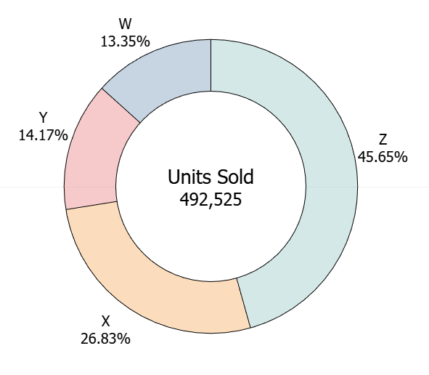
Sales by Channel
Channel Z has sold the most units at 46%
Distribution of products sold are similar across all products
Notes:
Customer preference?
CX efforts

Slide 7
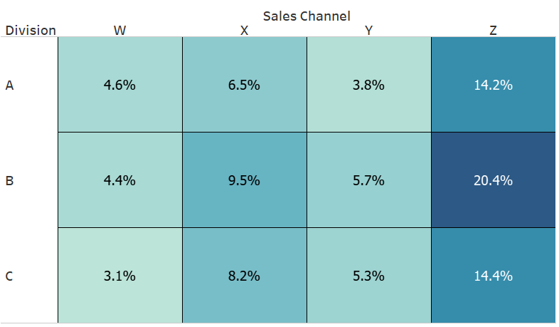
Division and Sales Channel

Slide 8
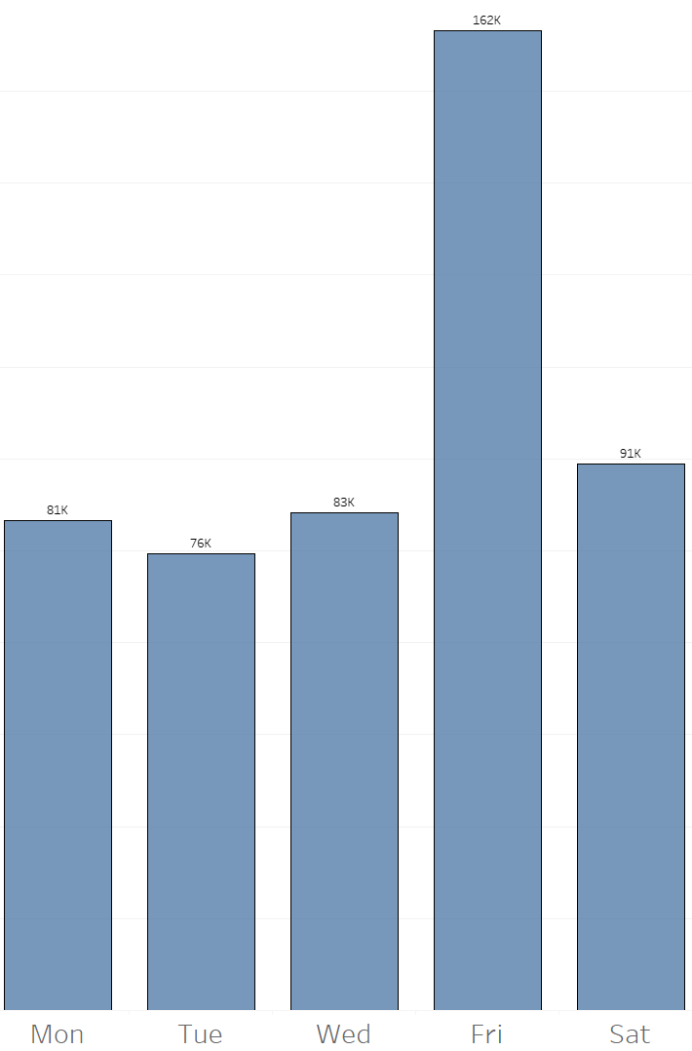
Sales Opportunities
Units offered: 161.6m
Total units sold: 493k
Conversion rate: 0.3%
Most of our sales occur on Fridays
Notes:
-The conversation rate is extremely low at 0.3% of total units offered
-Most of our sales occur on Fridays
Considerations:
-Set goals of improving metrics.
-If we can improve sales conversation by 10% (from 0.3% to 0.33%), this can increase units sold from 492k to 533k (see calculation 1)
-If we can improve units offered by 10% (from 161,585,962 to 177,744,558) and also achieve a 0.33% conversation rate, this can increase units sold from 492k to 587k(see calculation 2)
-Allocate our full-time employee (FTE) sources to accommodate higher volumes on Fridays
Calculation 1 – 161,585,962 units offered with a 492,525 units sold is a 0.3% conversation rate. Increasing conversation rate by 10% is 0.33%. 161,585,962 * .0033 = 533,233
Calculation 2 – 10% increase of 161,585,962 units offered is 177,744,558. A conversation rate of 0.33% of units offered is 586,557

Slide 9

Recommendations
Increase marketing efforts across other products
-Products 11 and 12 which are higher revenue products
Consider discontinuing products with low sales and poor outlook
-7, 10, 13, and 14 each have less than 220 sales
Notes:
Data Analysis
Analysis Scope: What insights can you derive from this data that will help improve business performance? As part of the analysis, you should be able to tell the team what other questions you’d ask of this data if you had more time.
Deliverables: PPT presentation and Excel file with completed data analysis (The deck should be intended for Director level and above audience).
Time: 3 hours - please upload your PPT and analysis within 3 hours

Slide 10
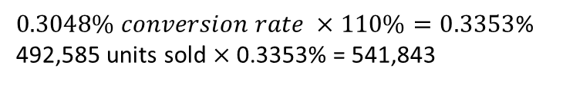

Recommendations
Merge “Other division” with the rest
Set goals to increase units offered and conversion rates
Sales goals
$$492,585 units sold ×110\%=541,843$$
$0.3048\% conversion rate ×110\%=0.3353$%
492,585 units sold $×$ 0.3353% = 541,843
Notes:
Data Analysis
Analysis Scope: What insights can you derive from this data that will help improve business performance? As part of the analysis, you should be able to tell the team what other questions you’d ask of this data if you had more time.
Deliverables: PPT presentation and Excel file with completed data analysis (The deck should be intended for Director level and above audience).
Time: 3 hours - please upload your PPT and analysis within 3 hours

Slide 11
Next Steps
Gather expense and profits data for each product
Without product expenses, we are not able to measure profitability.
Revenue by full-time employees (FTEs)
Customer satisfaction for divisions and channels
Measuring the client experience can help identify pain-points and opportunities.
Additional data is required for seasonality and trends analysis
This data set is limited to six days of the year.
A time series analysis can help identify trends and seasonality in our sales.
How many opportunities were there to offer units to customers
If this was a call center, how many total calls did our employees take?
Can help track employee performance and identify training opportunities
Sales and operational goals to measure business impact
What are our enterprise goals and how can we turn these sales figures into KPI’s?
Economic and demographic data
Regional analysis of each market can maximum growth potential of each product.
Notes:
Expense and profits for each product
Without product expenses, we are not able to measure profitability.
While products 3, 2, and 4 are our top sellers, they may have low profit margins
Client satisfaction for divisions and channels
Measuring the client experience can help identify pain-points and opportunities
Data for a longer period of time to analyze seasonality and trends
This data set is limited to six days of the year.
A time series analysis can help identify trends and seasonality in our sales
How many opportunities were there to offer units to customers
If this was a call center, how many total calls did our employees take?
Measuring the number of total calls taken can give us an idea of how often clients are offered our products
Sales and operational goals to measure business impact
What are our enterprise goals and how can we turn these sales figures into KPI’s?

Slide 12
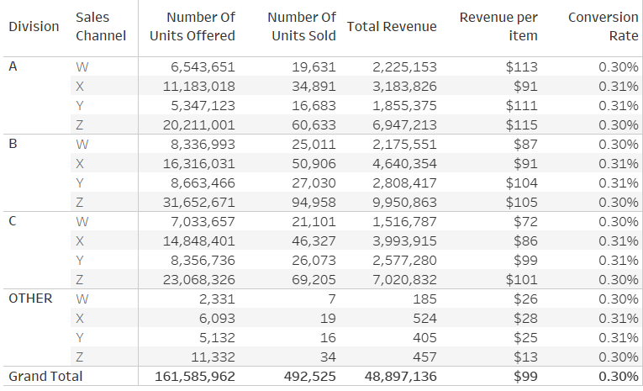
Appendix – Division and Sales

Slide 13
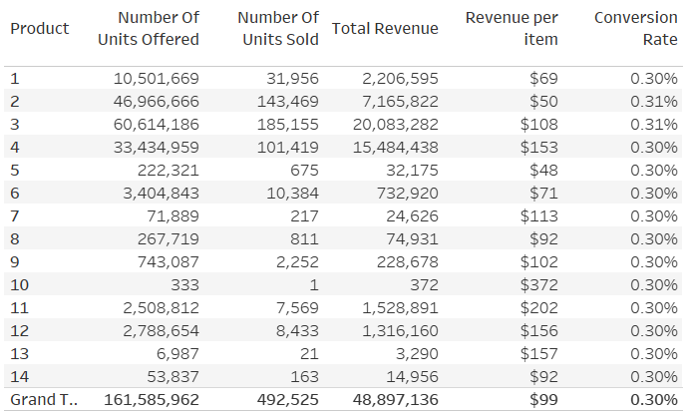
Appendix - Products

